Slide 1
Stream Architecture Design Guide

Slide 2



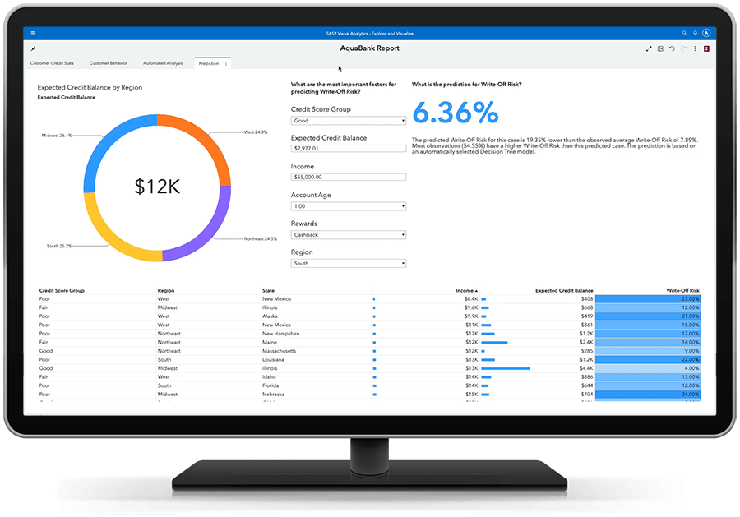













Streaming System Design Considerations
Requirements
Desig
Analyze
Store
Display
Ingest
long
short
Alerts
Platform

